Slide 1

Project 3:
Supply Chain Management Dashboard
By: Umesh Uday Salvi
UNID: UM2025045

Slide 2
Table of Contents
Introduction
Data Sources
Key Metrics
Outcomes

Slide 3
Introduction
Supply Chain Management Dashboard is designed to offer a distinctive view of the Supply Chain financial performance of a business
Supply Chain Management Dashboard created with the assistance of Data Visualization Tool named Tableau
Dashboard as earlier mentioned gives an overview of the financial performance across various Cities and by the Transportation modes for increasing the Supply Chain profitability.

Slide 4
Data Sources
Data Visualization tools used for creating Supply Chain Management Dashboard is named as Tableau.
Dataset is available, provided by a link. Dataset can be utilized for the creation of the Supply Chain Management Report.
Connect to Data: Open Tableau, click connect, and import the dataset (CSV, Excel, or Database)

Slide 5
Key Metrics
Supply Chain Management Dashboard highlights the following key performance indicators such as:
Total Revenue Generated
Total Orders Quantity
Total Availability
Production Volumes

Slide 6
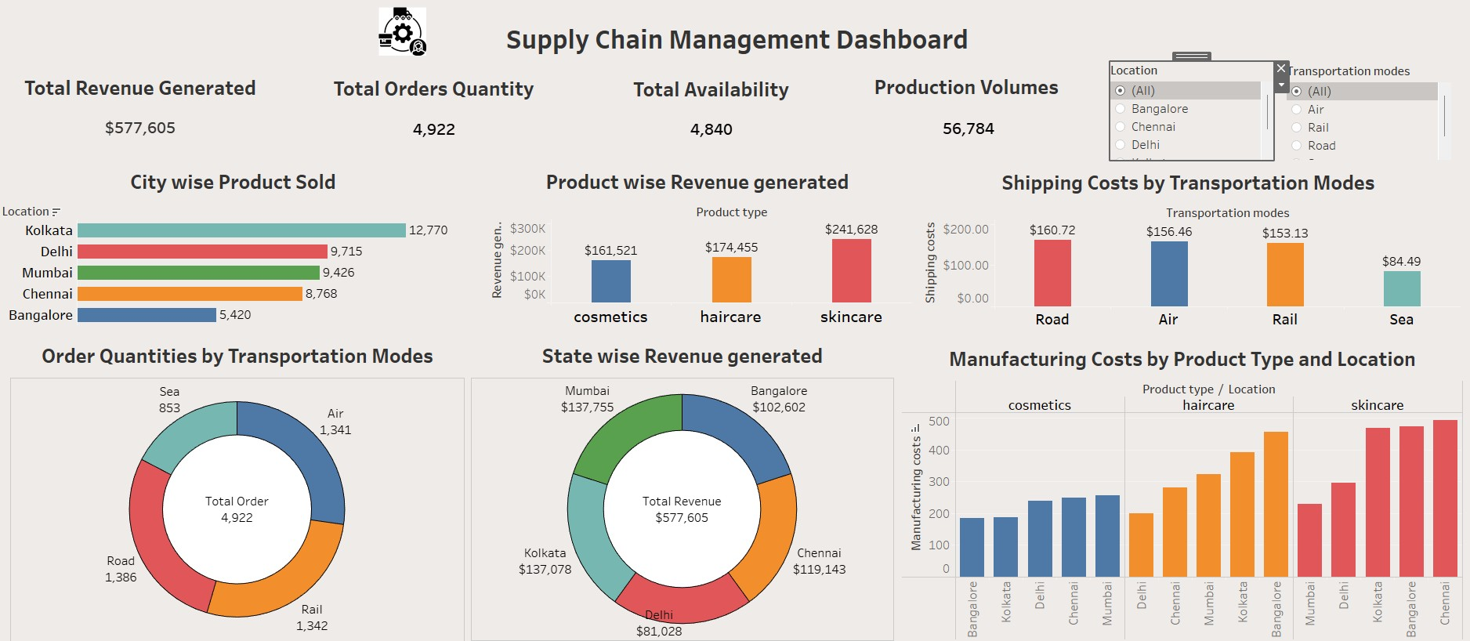
Outcomes: Supply Chain Management Performance

Slide 7
Conclusion
Supply Chain Management Dashboard provides insights related to the financial performance of a business across different cities and by the Transportation Modes, with the assistance of the key financial metrics such as Total Revenue Generated, Total Orders Quantity, Total Availability, and Production Volumes.
Necessary adjustments can be made to improve the performance of the productivity of the business across different cities, by predicting the financial performance of the products, which can be estimated by observing the Supply Chain Management Dashboard.

